Slide 1



University Institute of Engineering
DEPARTMENT OF COMPUTER SCIENCE & ENGINEERING
Subject Name: Software Engineering
Subject Code: 23CST-206
Software Design
Er. Jagmeet Kaur
E8387
ASSISTANT PROFESSOR
CSE
DISCOVER . LEARN . EMPOWER

Slide 2
Chapter-4 Software Design
Approaches to Software design

Slide 3
Software Design
Software design is a process to conceptualize the software requirements into software implementation.
Software design takes the user requirements as challenges and tries to find optimum solution.
While the software is being conceptualized, a plan is chalked out to find the best possible design for implementing the intended solution.

Slide 4
Software Design
A good system design is to organize the program modules in such a way that are easy to develop and change.
Structured design techniques help developers to deal with the size and complexity of programs.
Analysts create instructions for the developers about how code should be written and how pieces of code should fit together to form a program.

Slide 5
Importance
If any pre-existing code needs to be understood, organized and pieced together.
It is common for the project team to have to write some code and produce original programs that support the application logic of the system.

Slide 6
Structured Design
Structured design is a conceptualization of problem into several well-organized elements of solution.
It is basically concerned with the solution design.
Benefit of structured design is, it gives better understanding of how the problem is being solved.
Structured design also makes it simpler for designer to concentrate on the problem more accurately.

Slide 7
Structured Design
The small pieces of problem are solved by means of solution modules.
Structured design emphasis that these modules be well organized in order to achieve precise solution.
These modules are arranged in hierarchy.
They communicate with each other. A good structured design always follows some rules for communication among multiple modules, namely -
Cohesion - grouping of all functionally related elements.
Coupling - communication between different modules.
A good structured design has high cohesion and low coupling arrangements.

Slide 8
Function Oriented Design
In function-oriented design, the system is comprised of many smaller sub-systems known as functions.
These functions are capable of performing significant task in the system.
The system is considered as top view of all functions.
Function oriented design inherits some properties of structured design where divide and conquer methodology is used.

Slide 9
Function Oriented Design
This design mechanism divides the whole system into smaller functions, which provides means of abstraction by concealing the information and their operation.
These functional modules can share information among themselves by means of information passing and using information available globally.

Slide 10
Function Oriented Design
Another characteristic of functions is that when a program calls a function, the function changes the state of the program, which sometimes is not acceptable by other modules.
Function oriented design works well where the system state does not matter and program/functions work on input rather than on a state.

Slide 11
Design Process
The whole system is seen as how data flows in the system by means of data flow diagram.
DFD depicts how functions changes data and state of entire system.
The entire system is logically broken down into smaller units known as functions on the basis of their operation in the system.
Each function is then described at large.

Slide 12
Object Oriented Design
Object oriented design works around the entities and their characteristics instead of functions involved in the software system.
This design strategies focuses on entities and its characteristics.
The whole concept of software solution revolves around the engaged entities.

Slide 13
Object Oriented Design
Let us see the important concepts of Object Oriented Design:
Objects - All entities involved in the solution design are known as objects. For example, person, banks, company and customers are treated as objects. Every entity has some attributes associated to it and has some methods to perform on the attributes.
Classes - A class is a generalized description of an object. An object is an instance of a class. Class defines all the attributes, which an object can have and methods, which defines the functionality of the object.
In the solution design, attributes are stored as variables and functionalities are defined by means of methods or procedures.

Slide 14
Object Oriented Design
Encapsulation - In OOD, the attributes (data variables) and methods (operation on the data) are bundled together is called encapsulation. Encapsulation not only bundles important information of an object together, but also restricts access of the data and methods from the outside world. This is called information hiding.
Inheritance - OOD allows similar classes to stack up in hierarchical manner where the lower or sub-classes can import, implement and re-use allowed variables and methods from their immediate super classes. This property of OOD is known as inheritance. This makes it easier to define specific class and to create generalized classes from specific ones.

Slide 15
Object Oriented Design
Polymorphism - OOD languages provide a mechanism where methods performing similar tasks but vary in arguments, can be assigned same name.
This is called polymorphism, which allows a single interface performing tasks for different types.
Depending upon how the function is invoked, respective portion of the code gets executed.

Slide 16
Design Process
Software design process can be perceived as series of well-defined steps. Though it varies according to design approach (function oriented or object oriented, yet It may have the following steps involved:
A solution design is created from requirement or previous used system and/or system sequence diagram.
Objects are identified and grouped into classes on behalf of similarity in attribute characteristics.
Class hierarchy and relation among them is defined.
Application framework is defined.

Slide 17
Software Design Approaches
Top Down Design
We know that a system is composed of more than one sub-systems and it contains a number of components.
Further, these sub-systems and components may have their on set of sub-system and components and creates hierarchical structure in the system.
Top-down design takes the whole software system as one entity and then decomposes it to achieve more than one sub-system or component based on some characteristics.
Each sub-system or component is then treated as a system and decomposed further.

Slide 18
Top Down Design
This process keeps on running until the lowest level of system in the top-down hierarchy is achieved.
Top-down design starts with a generalized model of system and keeps on defining the more specific part of it.
When all components are composed the whole system comes into existence.
Top-down design is more suitable when the software solution needs to be designed from scratch and specific details are unknown.

Slide 19
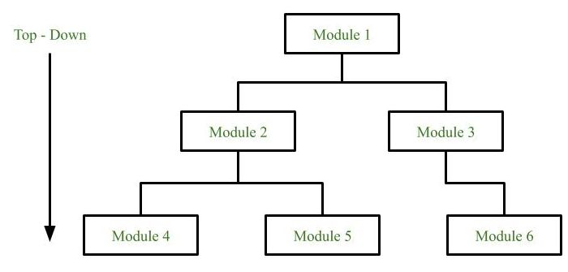
Top Down Design

Slide 20
Top Down Design
Advantages:
The main advantage of top down approach is that its strong focus on requirements helps to make a design responsive according to its requirements.
Disadvantages:
Project and system boundaries tends to be application specification oriented. Thus it is more likely that advantages of component reuse will be missed.
The system is likely to miss, the benefits of a well-structured, simple architecture.

Slide 21
Bottom-up Design
The bottom up design model starts with most specific and basic components.
It proceeds with composing higher level of components by using basic or lower level components.
It keeps creating higher level components until the desired system is not evolved as one single component.
With each higher level, the amount of abstraction is increased.

Slide 22
Bottom-up Design
Bottom-up strategy is more suitable when a system needs to be created from some existing system, where the basic primitives can be used in the newer system.
Both, top-down and bottom-up approaches are not practical individually. Instead, a good combination of both is used.

Slide 23
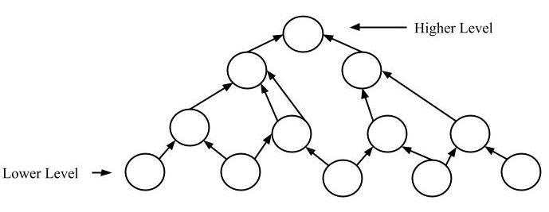
Bottom-up Design

Slide 24
Bottom-up Design
Advantages:
The economics can result when general solutions can be reused.
It can be used to hide the low-level details of implementation and be merged with top-down technique.
Disadvantages:
It is not so closely related to the structure of the problem.
High quality bottom-up solutions are very hard to construct.
It leads to proliferation of ‘potentially useful’ functions rather than most appropriate ones.

Slide 25
Hybrid Design
Hybrid Design: It is a combination of both the top – down and bottom – up design strategies. In this we can reuse the modules.

Slide 26
References
https://www.tutorialspoint.com/software_engineering/software_design_basics.htm#:~:text=Software%20design%20is%20a%20process,in%20software%20coding%20and%20implementation.&text=Software%20design%20is%20the%20first,problem%20domain%20to%20solution%20domain.
https://www.geeksforgeeks.org/software-engineering-software-design-process/
https://www.javatpoint.com/software-engineering-software-design

Slide 27
THANK YOU

